Slide 1
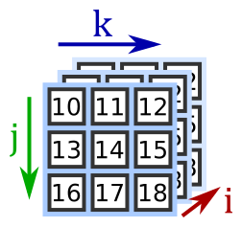
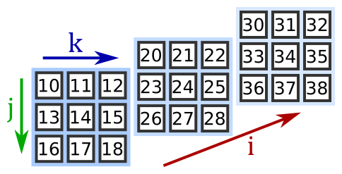
E = np.zeros((8760, 9, 4))
E = np.zeros((8760, 9, 4))
= a stack of 8760 matrices,
each with 9 rows and 4 columns
E = np.zeros((9, 8760, 4))
= a stack of 9 matrices,
each with 8760 rows and 4 columns
E = np.zeros((4, 8760, 9))
= a stack of 4 matrices,
each with 8760 rows and 9 columns

